Slide 1
CRM Sales Opportunities Analysis
By Khushi Kansara

Slide 2
Introduction :
The Data contains B2B Sales Opportunities from CRM Database of the company that sells computer hardware with information on accounts, products, sales team and sales opportunities.
Task to perform:
Data Overview
Data Cleaning
Data Modelling
Data Visualization
Analysis

Slide 3
Table | Field | Description
accounts | account | Company name
accounts | sector | Industry
accounts | year_established | Year Established
accounts | revenue | Annual revenue (in millions of USD)
accounts | employees | Number of employees
accounts | office_location | Headquarters
accounts | subsidiary_of | Parent company
products | product | Product name
products | series | Product series
products | sales_price | Suggested retail price
sales_teams | sales_agent | Sales agent
sales_teams | manager | Respective sales manager
sales_teams | regional_office | Regional office
sales_pipeline | opportunity_id | Unique identifier
sales_pipeline | sales_agent | Sales agent
sales_pipeline | product | Product name
sales_pipeline | account | Company name
sales_pipeline | deal_stage | Sales pipeline stage (Prospecting > Engaging > Won / Lost)
sales_pipeline | engage_date | Date in which the "Engaging" deal stage was initiated
sales_pipeline | close_date | Date in which the deal was "Won" or "Lost"
sales_pipeline | close_value | Revenue from the deal
Data Overview

Slide 4
Interactive Dashboard
CRM Sales Overview

Slide 5
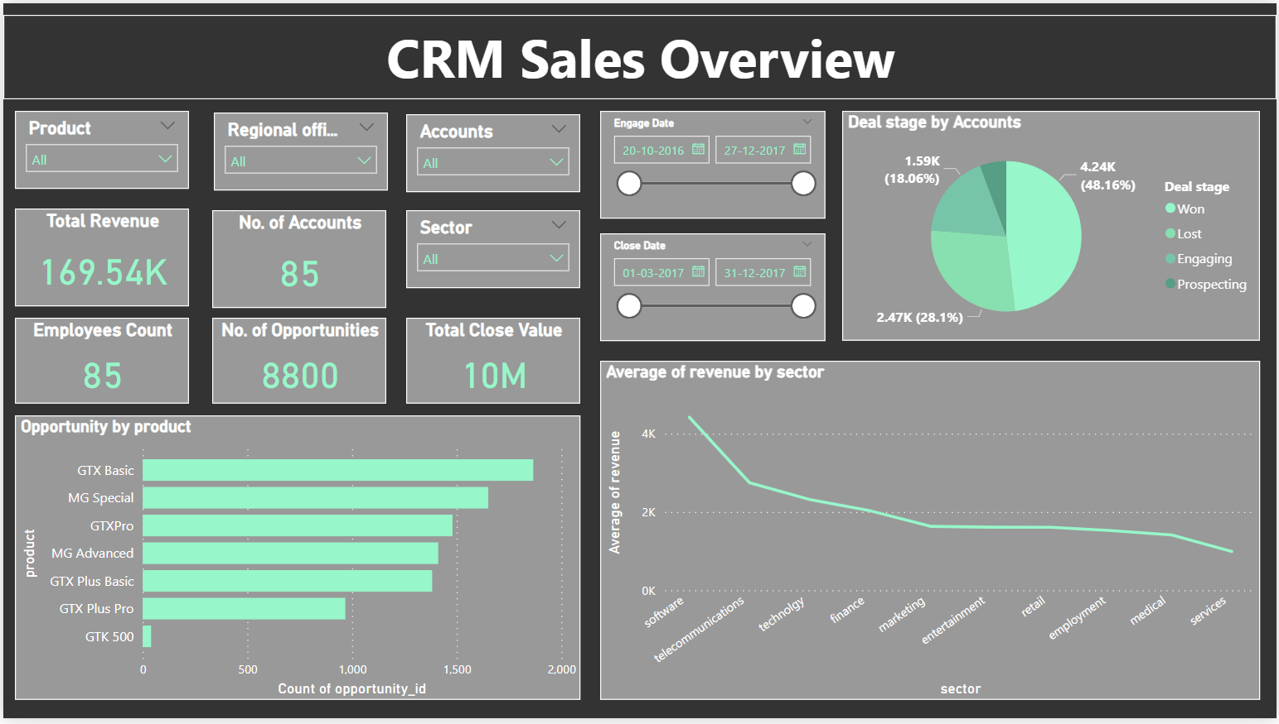

Slide 6
Interactive Dashboard
Revenue Distribution

Slide 7
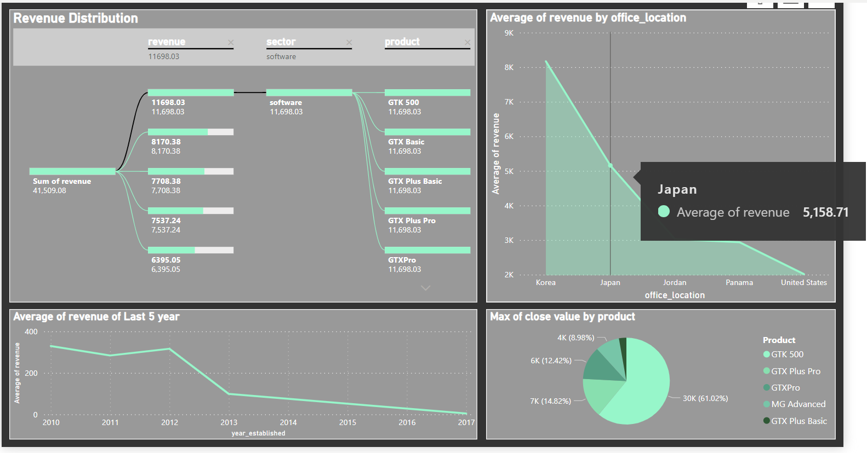

Slide 8
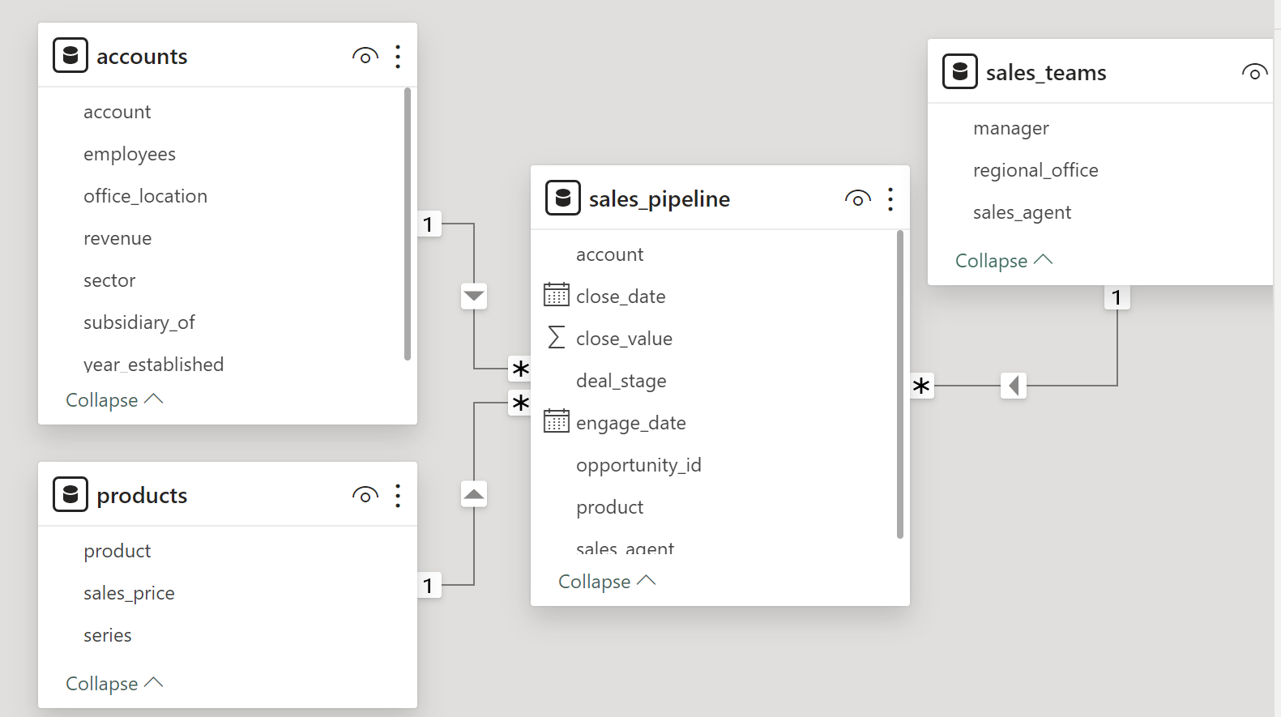

Data Modeling
Data visualization
Insights & Recommendation
Process
Data Understanding
Transform Data into Power Query
Transformation of Data to Power BI

